Slide 1
Density Estimation II
Statistical Data Analysis, 2023

Slide 2
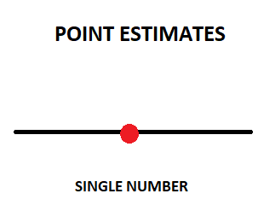
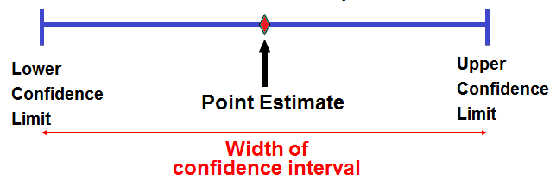
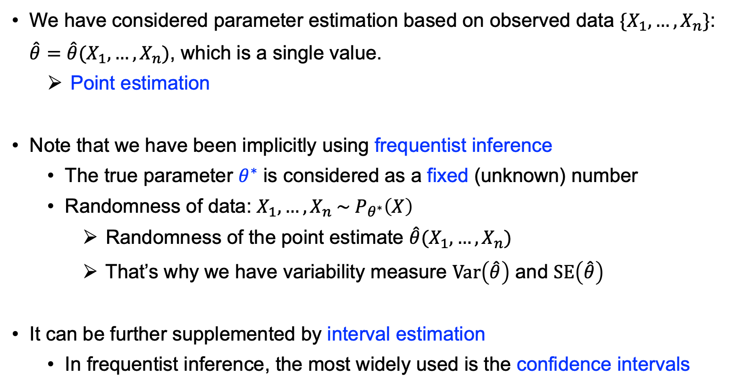
Interval Estimation
We have considered parameter estimation based on observed data $\{X_{1},…,X_{n}\}$: $\hat{θ}=\hat{θ}(X_{1},…, X_{n})$, which is a single value.
Point estimation
Note that we have been implicitly using frequentist inference
The true parameter $θ^{∗}$ is considered as a fixed (unknown) number
Randomness of data: $X_{1},…,X_{n} \sim P_{θ^{∗}}\left(X\right)$
Randomness of the point estimate $\hat{θ}(X_{1},…, X_{n})$
That’s why we have variability measure $Var\left(\hat{θ}\right)$ and $SE\left(\hat{θ}\right)$
It can be further supplemented by interval estimation
In frequentist inference, the most widely used is the confidence intervals

Slide 3
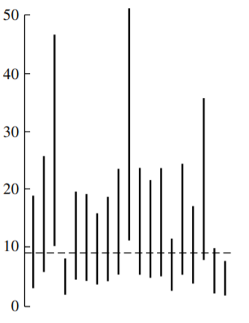
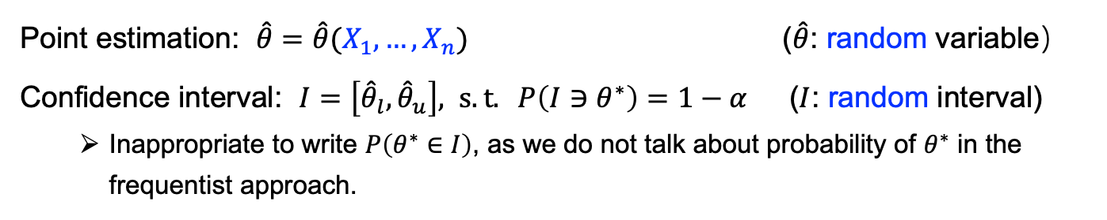
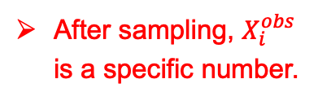
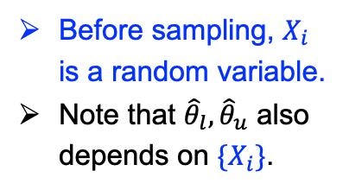
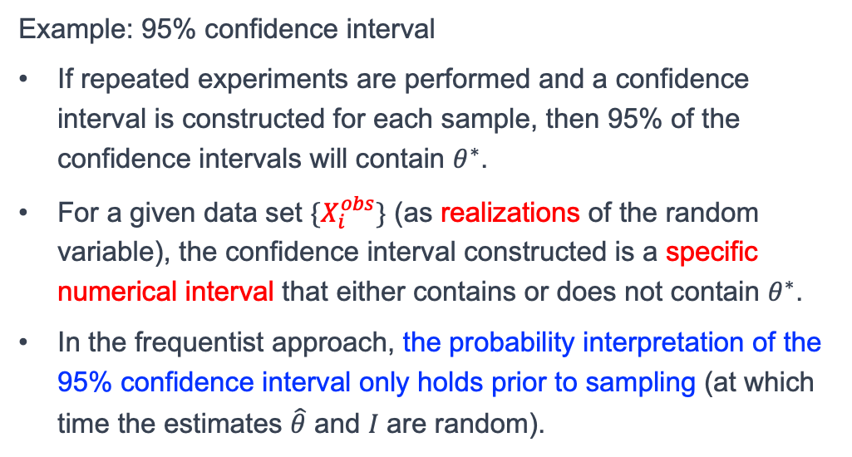
Confidence Interval
Point estimation: $\hat{θ}=\hat{θ}(X_{1},…, X_{n})$ ($\hat{θ}$: random variable）
Confidence interval: $I=\left[{\hat{θ}}_{l},{\hat{θ}}_{u}\right], s.t. P\left(I∋θ^{∗}\right)=1−α$ ($I$: random interval)
Inappropriate to write $P\left(θ^{∗}∈I\right)$, as we do not talk about probability of $θ^{∗}$ in the frequentist approach.
Before sampling, $X_{i}$ is a random variable.
Note that ${\hat{θ}}_{l},{\hat{θ}}_{u}$ also depends on $\{X_{i}\}$.
Example: 95% confidence interval
If repeated experiments are performed and a confidence interval is constructed for each sample, then 95% of the confidence intervals will contain $θ^{∗}$.
For a given data set $\{X_{i}^{obs}\}$ (as realizations of the random variable), the confidence interval constructed is a specific numerical interval that either contains or does not contain $θ^{∗}$.
In the frequentist approach, the probability interpretation of the 95% confidence interval only holds prior to sampling (at which time the estimates $\hat{θ}$ and 𝐼 are random).
After sampling, $X_{i}^{obs}$ is a specific number.
[Ref: Chap 8, MSDA3, J. A. Rice]
Notes:
Definition of confidence interval: It refers to the probability that a random interval contains the true parameter, rather than the probability that the true parameter falls within the random interval.
In the frequentist approach: the true parameter is a fixed numerical value.

Slide 4

单选题
1分
The 95% confidence interval of the expectation value of a sample data is [0.2, 0.4]. Which of the following is correct?
A
The interval [0.2, 0.4] contains the population mean with 95% probability.
B
Repeat the experiment many times, and 95% of the time, the sample mean falls in the interval [0.2, 0.4].
C
95% of the sample data points fall within the interval [0.2, 0.4].
D
Cannot extract probabilistic information about the population mean from the numeric interval [0.2, 0.4].
提交
Notes:
Answer: D
As before, we cannot talk about $P([0.2, 0.4]∋θ^{∗})$. The specific numerical interval [0.2, 0.4] either include or exclude $θ^{∗}$ (no probability).
A 95% probability for a confidence interval is more of a description of an experiment + method of constructing a confidence interval, rather than a certain interval itself.

Slide 5
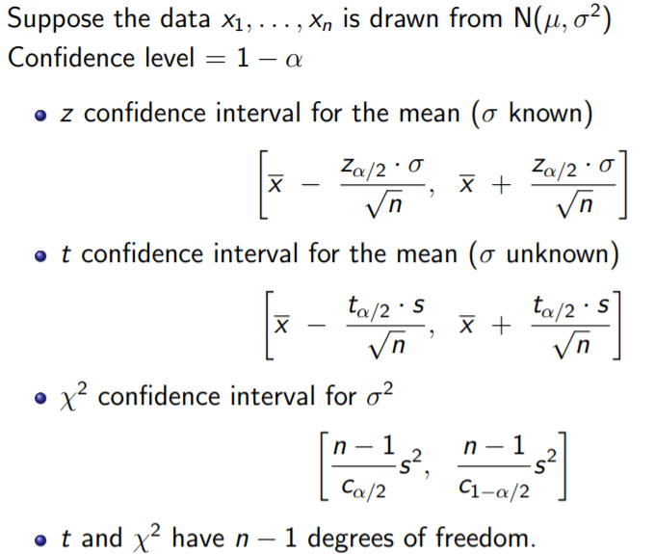
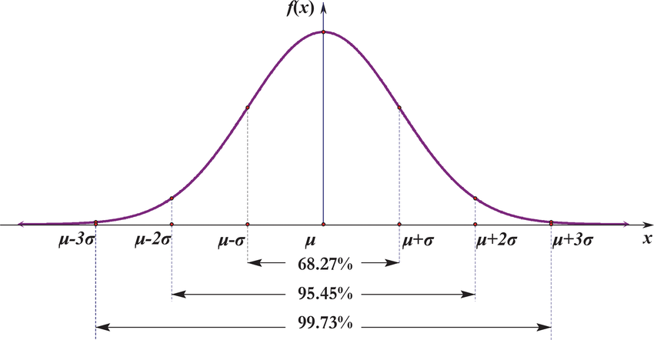
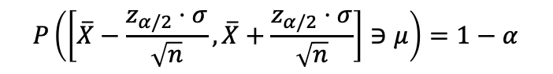
Computing Confidence Interval – Exact Solution
Exact solution exists for a few distributions, e.g., Gaussian and its derivatives:
$$P\left(\left[\overline{X}−\frac{z_{α/2}⋅σ}{\sqrt{n}},\overline{X}+\frac{z_{α/2}⋅σ}{\sqrt{n}}\right]∋μ\right)=1−α$$

Slide 6
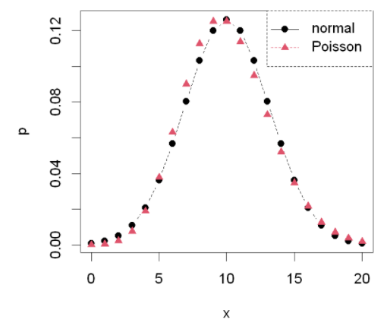
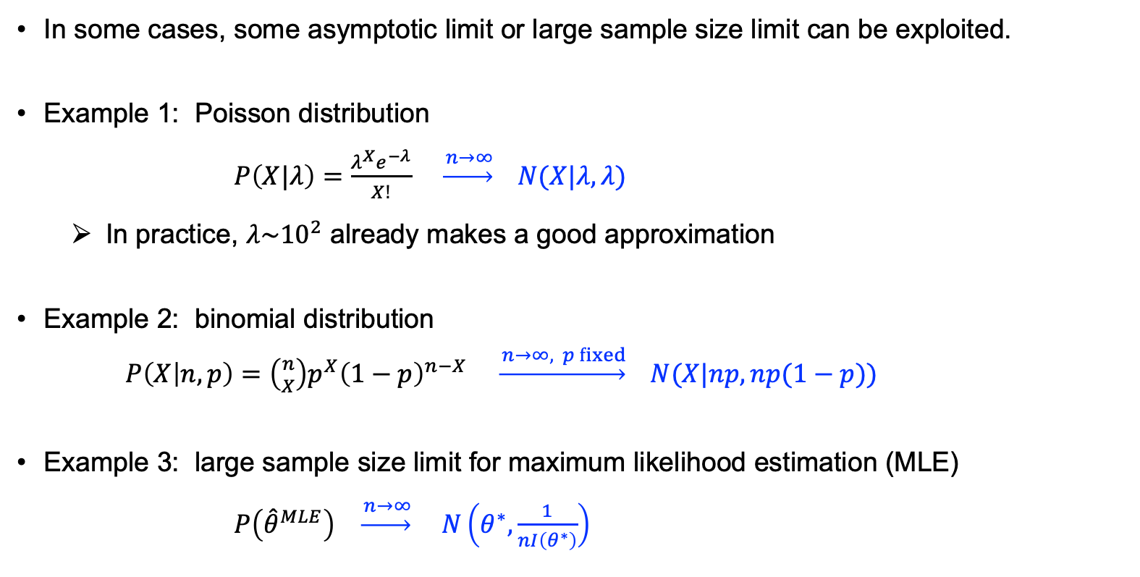
Computing Confidence Interval – Asymptotic
In some cases, some asymptotic limit or large sample size limit can be exploited.
Example 1: Poisson distribution
$P\left(X|λ\right)=\frac{λ^{X}e^{−λ}}{X!}$ $\underset{→}{ n→∞} N(X|λ,λ)$
In practice, $λ\sim {10}^{2}$ already makes a good approximation
Example 2: binomial distribution
$P\left(X | n,p\right)=\left({n \atop X}\right)p^{X}{\left(1−p\right)}^{n−X}$ $\underset{→}{ n→∞, p fixed} N(X|np, np(1−p))$
Example 3: large sample size limit for maximum likelihood estimation (MLE)
$P\left({\hat{θ}}^{MLE}\right) \underset{→}{ n→∞} N\left(θ^{∗}, \frac{1}{nI\left(θ^{∗}\right)}\right)$

Slide 7
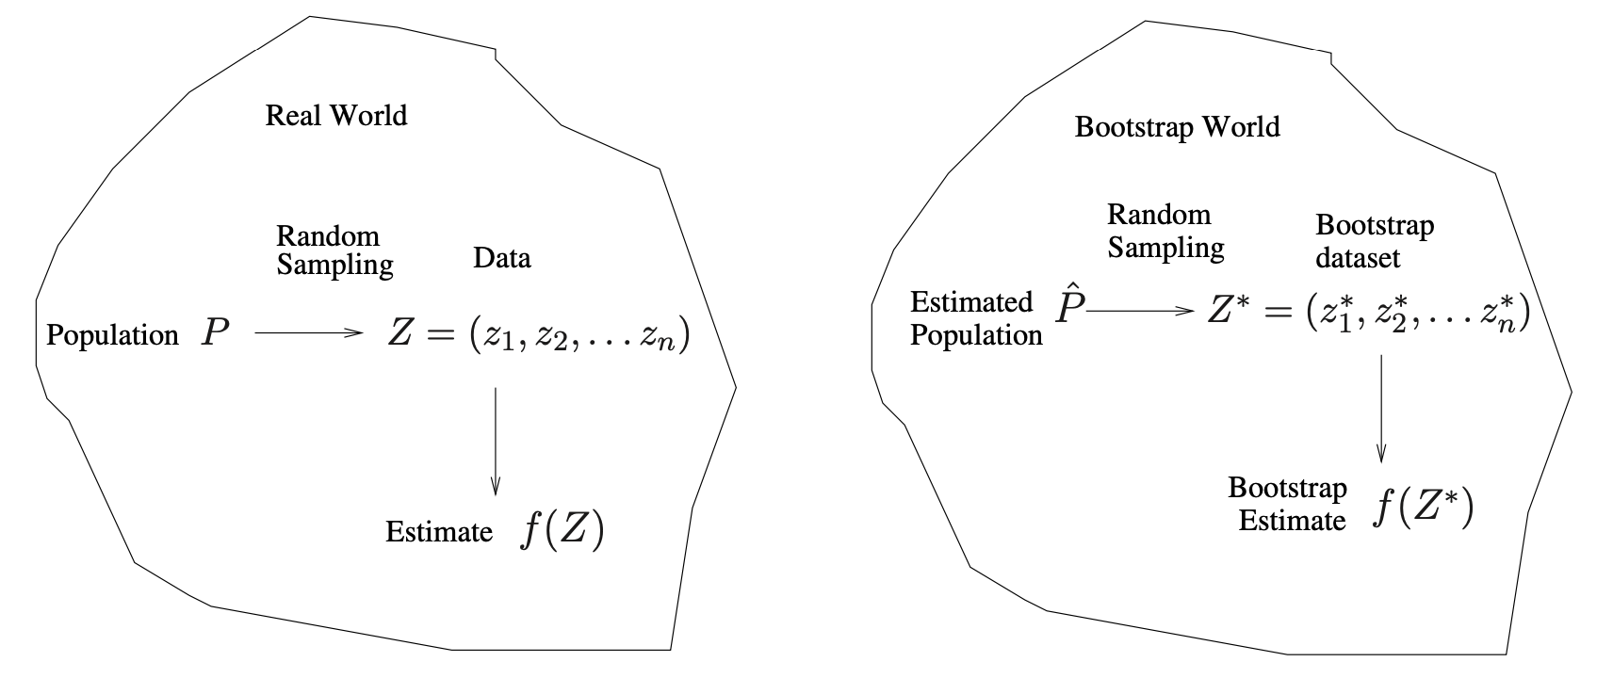
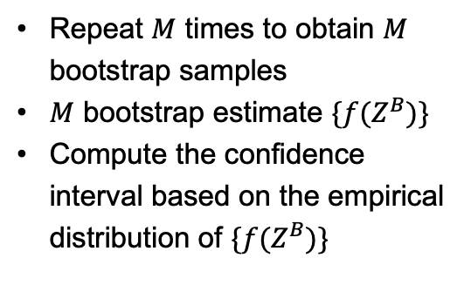
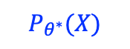
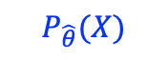
Computing Confidence Interval – Simulation
What if there is no exact solution or no asymptotic limit to exploit (e.g., sample size not big, not using MLE)?
Computer simulation provides good alternatives in these cases.
For computing confidence interval for parametric models, we can use the parametric bootstrap.
Repeat $M$ times to obtain $M$ bootstrap samples
$M$ bootstrap estimate $\{f(Z^{B})\}$
Compute the confidence interval based on the empirical distribution of $\{f(Z^{B})\}$
$$P_{θ^{∗}}(X)$$
$$P_{\hat{θ}}(X)$$
Some methods in R
write for loop (generic)…
boot package (generic)
fitdistrplus package (fitting univariate distribution)
Notes:
For non-parametric bootstrap, simply use the empirical distribution as an estimated population $\hat{P}$, which leads to a resampling approach.
After obtaining the bootstrap estimates $\{{\hat{θ}}^{B}\}$, there are different ways extracting the confidence interval, e.g., basic bootstrap or percentile bootstrap.

Slide 8
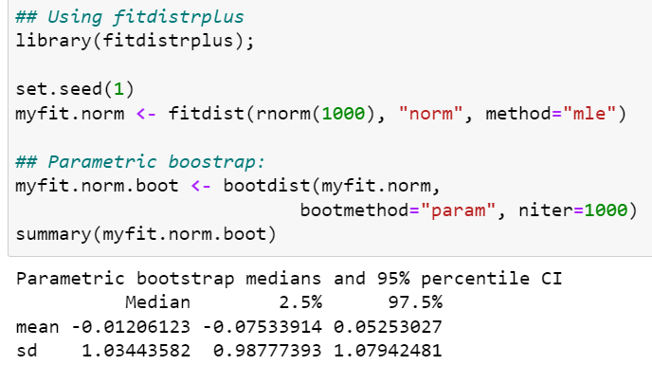
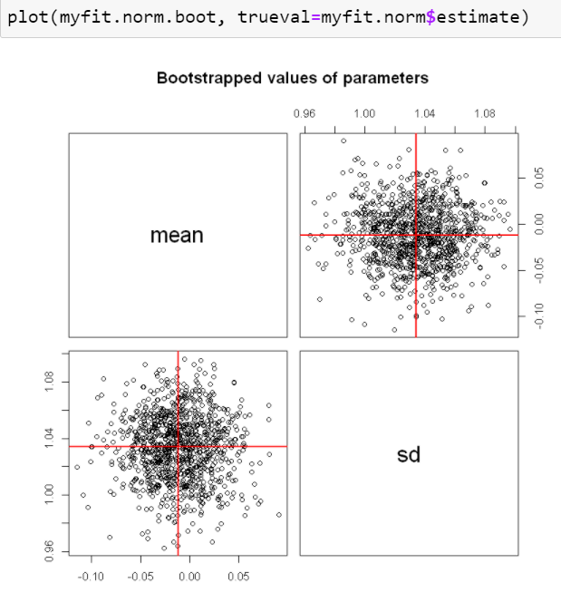
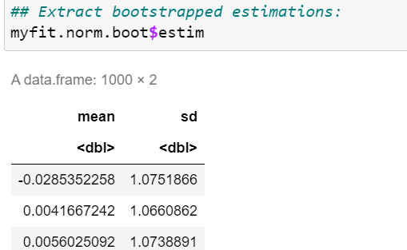
Computing Confidence Interval – by fitdistrplus::bootdist
Toy example:
For procedure of basic bootstrap, see Sec. 8.5, MSDA3 – J. A. Rice

Slide 9
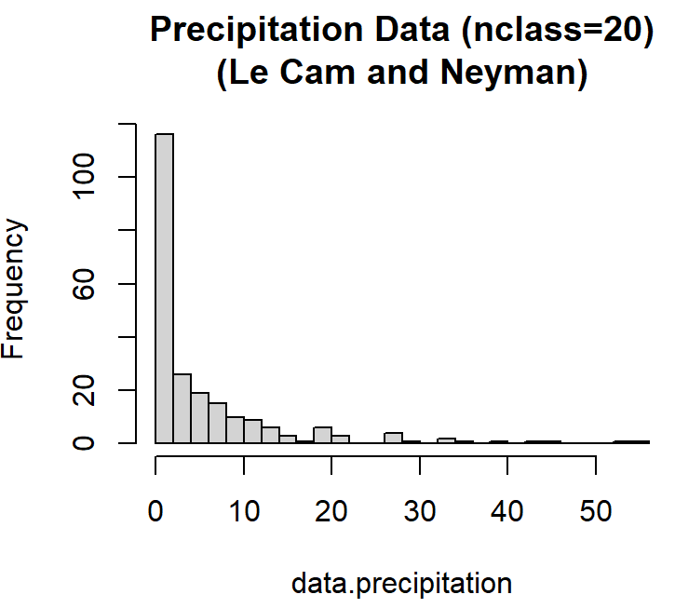
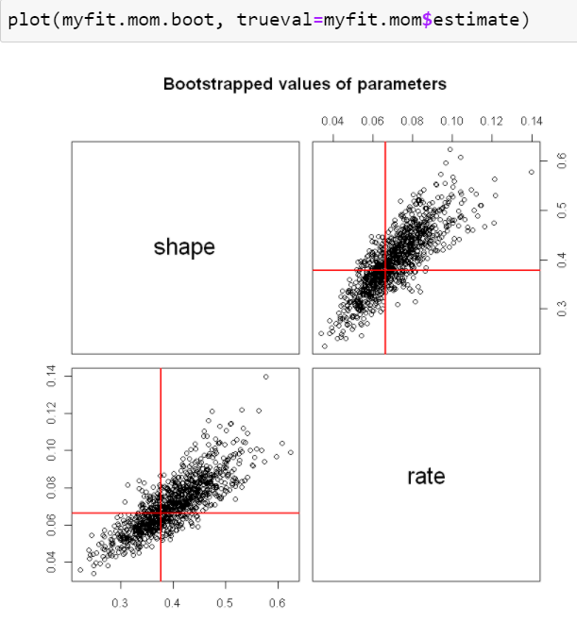
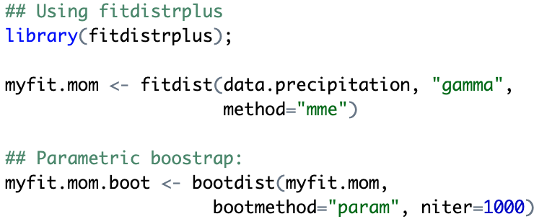
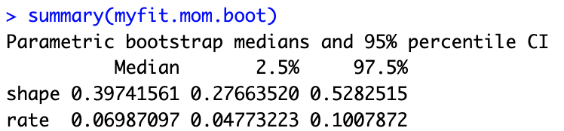
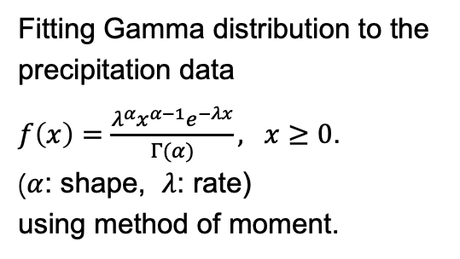
Computing Confidence Interval – by fitdistrplus::bootdist
Fitting Gamma distribution to the precipitation data
$f\left(x\right)=\frac{λ^{α}x^{α−1}e^{−λx}}{Γ(α)}, x≥0$.
($α$: shape, $λ$: rate)
using method of moment.
mm

Slide 10
Gaussian Mixture Models

Slide 11
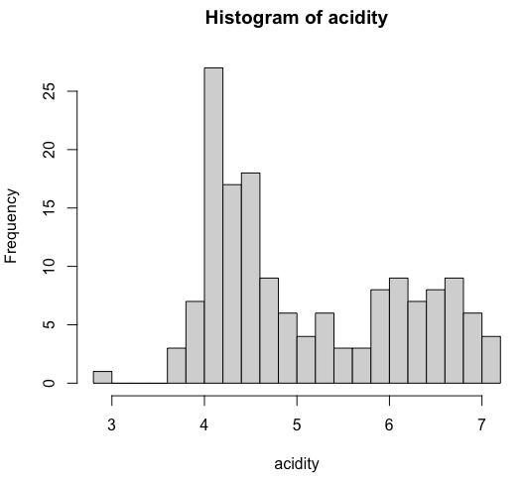

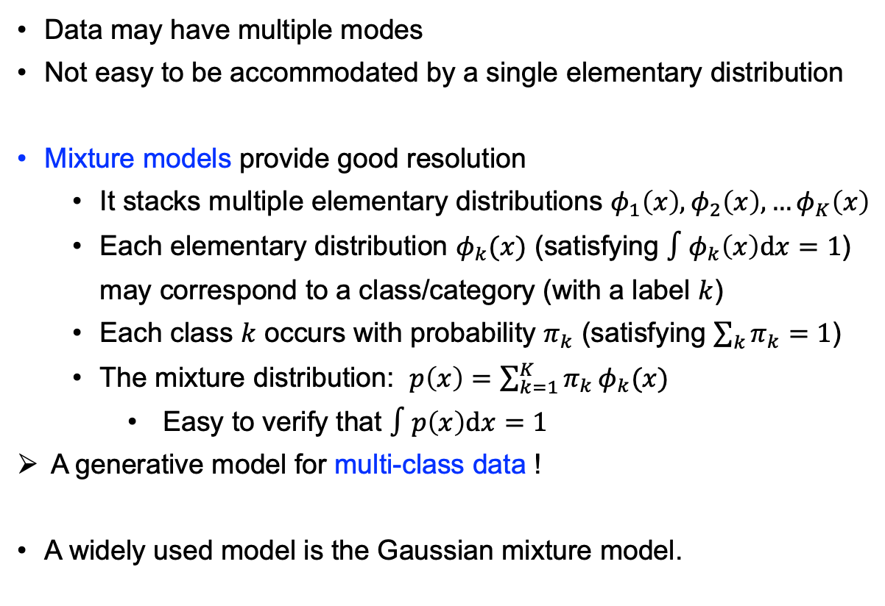
Multimodal Distribution (多峰分布)
Data may have multiple modes
Not easy to be accommodated by a single elementary distribution
Mixture models provide good resolution
It stacks multiple elementary distributions $φ_{1}\left(x\right),φ_{2}\left(x\right),…φ_{K}\left(x\right)$
Each elementary distribution $φ_{k}(x)$ (satisfying $∫φ_{k}\left(x\right)dx=1$) may correspond to a class/category (with a label $k$)
Each class $k$ occurs with probability $π_{k}$ (satisfying $\sum_{k}{π_{k}}=1$)
The mixture distribution: $p\left(x\right)=\sum_{k=1}^{K}{π_{k}}φ_{k}(x)$
Easy to verify that $∫p\left(x\right)dx=1$
A generative model for multi-class data !
A widely used model is the Gaussian mixture model.
Acidity index (155 lakes in the Northeastern US)

Slide 12
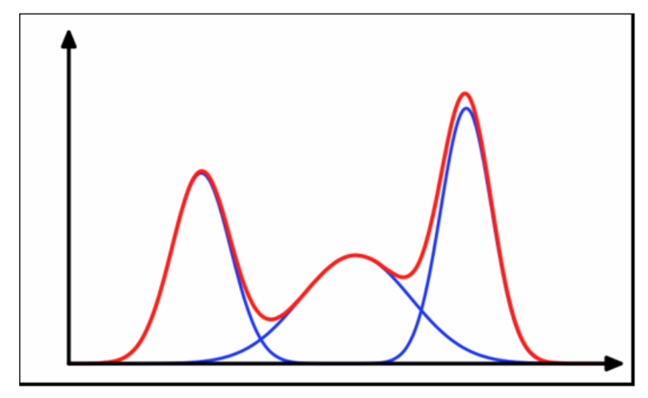
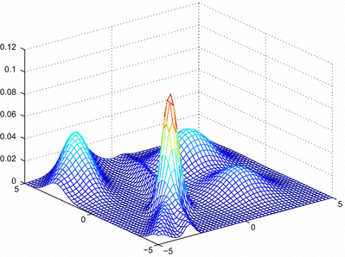
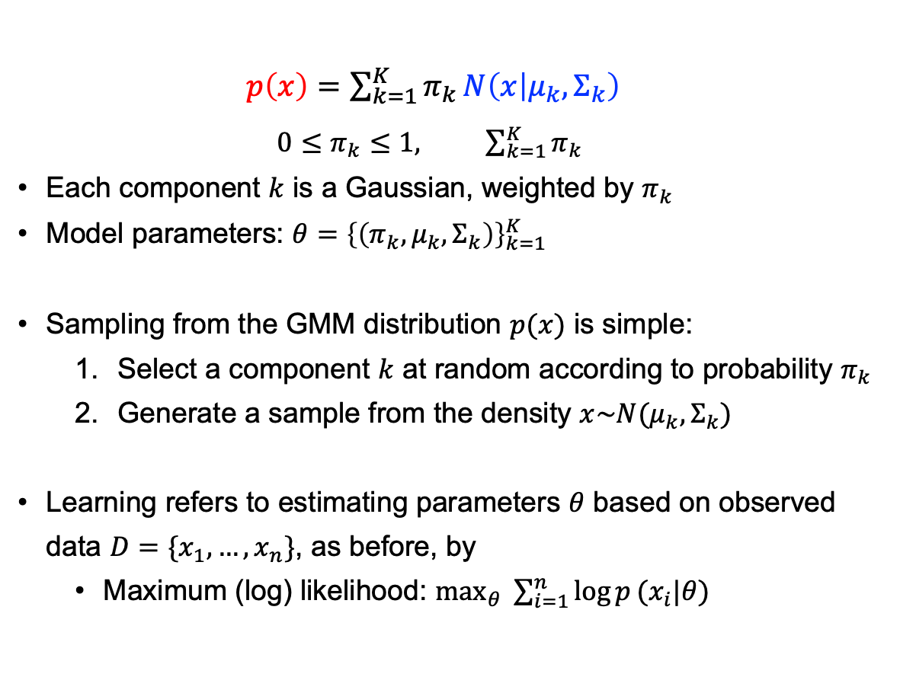
Gaussian Mixture Model (GMM)
$p\left(x\right)=\sum_{k=1}^{K}{π_{k}}N\left(x | μ_{k},Σ_{k}\right)$
$0≤π_{k}≤1, \sum_{k=1}^{K}{π_{k}}$
Each component $k$ is a Gaussian, weighted by $π_{k}$
Model parameters: $θ={\left\{\left(π_{k},μ_{k},Σ_{k}\right)\right\}}_{k=1}^{K}$
Sampling from the GMM distribution $p(x)$ is simple:
Select a component $k$ at random according to probability $π_{k}$
Generate a sample from the density $x\sim N(μ_{k},Σ_{k})$
Learning refers to estimating parameters $θ$ based on observed data $D=\{x_{1},…,x_{n}\}$, as before, by
Maximum (log) likelihood: $\max_{θ}{ \sum_{i=1}^{n}{\log{p}(x_{i}|θ) }}$
Anisotropic covariance is possible.
GMM is very flexible.
[Ref: Chap 9, Pattern Recognition and Machine Learning, C. M. Bishop (2006)]

Slide 13
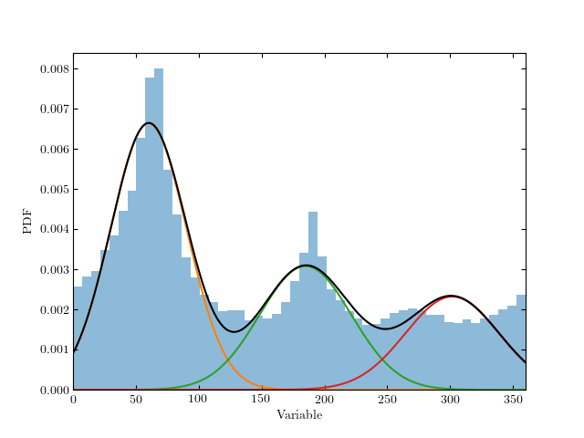
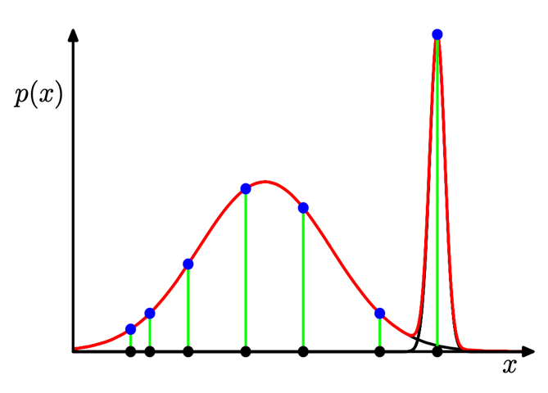
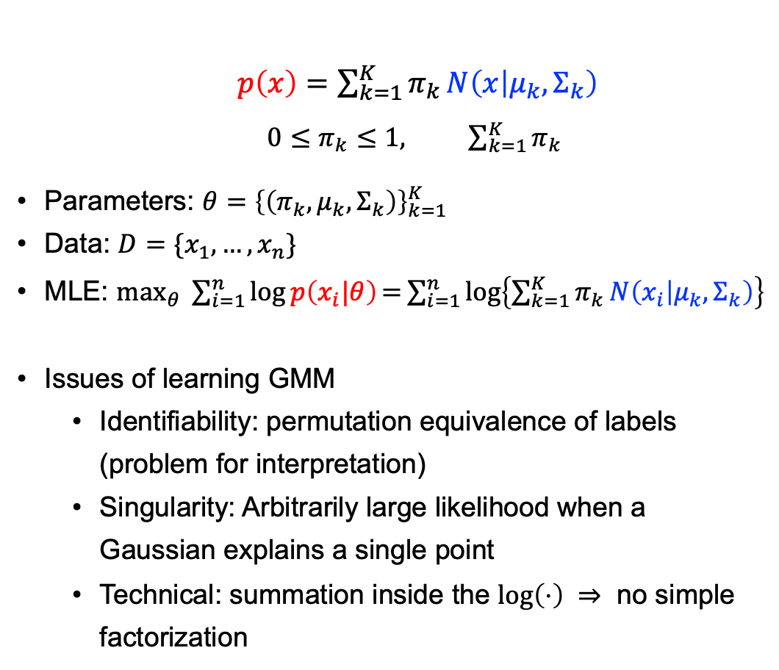
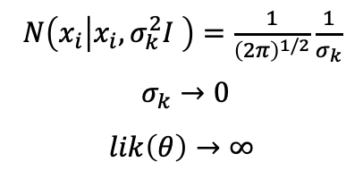
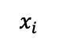
GMM – Parameter Estimation (Learning)
$p\left(x\right)=\sum_{k=1}^{K}{π_{k}}N\left(x | μ_{k},Σ_{k}\right)$
$0≤π_{k}≤1, \sum_{k=1}^{K}{π_{k}}$
Parameters: $θ={\left\{\left(π_{k},μ_{k},Σ_{k}\right)\right\}}_{k=1}^{K}$
Data: $D=\{x_{1},…,x_{n}\}$
MLE: $\max_{θ}{ \sum_{i=1}^{n}{\log{p\left(x_{i}|θ\right)}\text{=}\sum_{i=1}^{n}{\log\left\{\sum_{k=1}^{K}{π_{k}}N\left(x_{i} | μ_{k},Σ_{k}\right)\right\}}}}$
Issues of learning GMM
Identifiability: permutation equivalence of labels (problem for interpretation)
Singularity: Arbitrarily large likelihood when a Gaussian explains a single point
Technical: summation inside the $log\left(⋅\right) ⇒$ no simple factorization
$N\left(x_{i} | x_{i},σ_{k}^{2}I \right)=\frac{1}{{\left(2π\right)}^{1/2}}\frac{1}{σ_{k}}$
$σ_{k}→0$
$$lik\left(θ\right)→∞$$
$$x_{i}$$

Slide 14
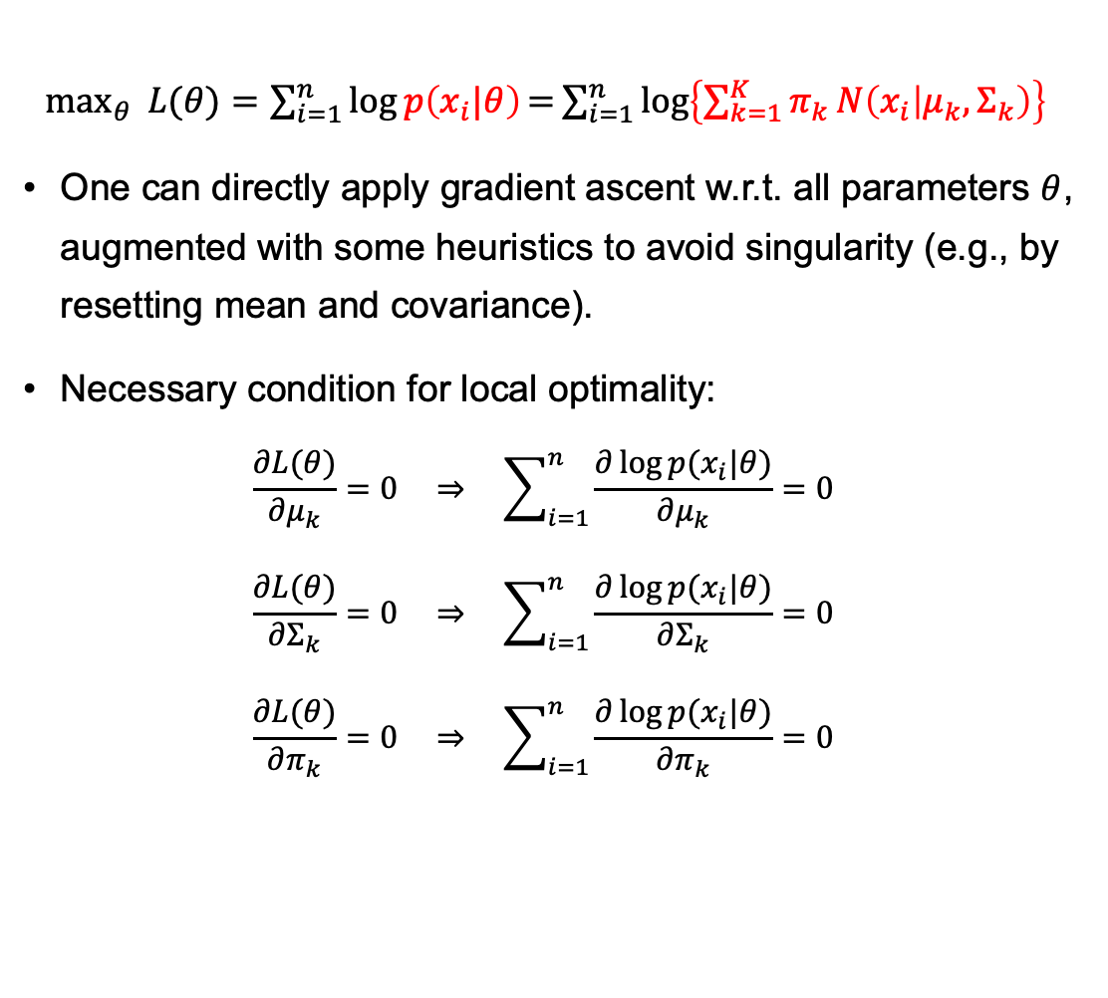
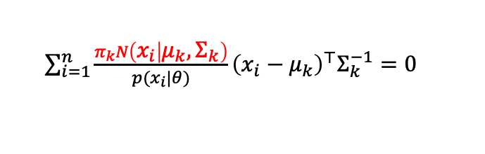
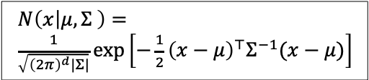
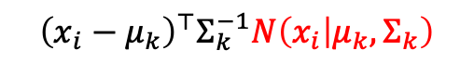
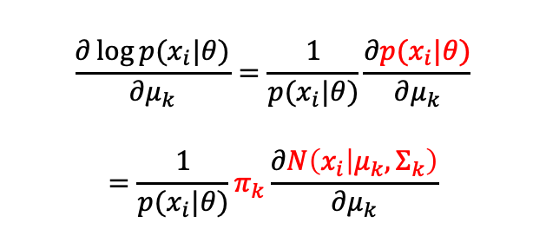
GMM – Parameter Estimation (Learning)
$\max_{θ}{ L(θ)=\sum_{i=1}^{n}{\log{p\left(x_{i}|θ\right)}\text{=}\sum_{i=1}^{n}{\log\left\{\sum_{k=1}^{K}{π_{k}}N\left(x_{i} | μ_{k},Σ_{k}\right)\right\}}}}$
One can directly apply gradient ascent w.r.t. all parameters $θ$, augmented with some heuristics to avoid singularity (e.g., by resetting mean and covariance).
Necessary condition for local optimality:
$$\frac{∂L(θ)}{∂μ_{k}}=0 ⇒ \sum_{i=1}^{n}{\frac{∂\log{p(x_{i}|θ)}}{∂μ_{k}}}=0$$
$$\frac{∂L(θ)}{∂Σ_{k}}=0 ⇒ \sum_{i=1}^{n}{\frac{∂\log{p(x_{i}|θ)}}{∂Σ_{k}}}=0$$
$$\frac{∂L(θ)}{∂π_{k}}=0 ⇒ \sum_{i=1}^{n}{\frac{∂\log{p(x_{i}|θ)}}{∂π_{k}}}=0$$
$N\left(x | μ,Σ \right)=$
$\frac{1}{\sqrt{{\left(2π\right)}^{d}|Σ|}}\exp\left[−\frac{1}{2}{\left(x−μ\right)}^{⊤}Σ^{−1}(x−μ)\right]$
$$\frac{∂\log{p(x_{i}|θ)}}{∂μ_{k}}=\frac{1}{p(x_{i}|θ)}\frac{∂p(x_{i}|θ)}{∂μ_{k}}$$
$$=\frac{1}{p(x_{i}|θ)}π_{k}\frac{∂N\left(x_{i} | μ_{k},Σ_{k}\right)}{∂μ_{k}}$$
$${\left(x_{i}−μ_{k}\right)}^{⊤}Σ_{k}^{−1}N\left(x_{i} | μ_{k},Σ_{k}\right)$$
$\sum_{i=1}^{n}{\frac{π_{k}N\left(x_{i} | μ_{k},Σ_{k}\right)}{p(x_{i}|θ)}}{\left(x_{i}−μ_{k}\right)}^{⊤}Σ_{k}^{−1}=0$

Slide 15
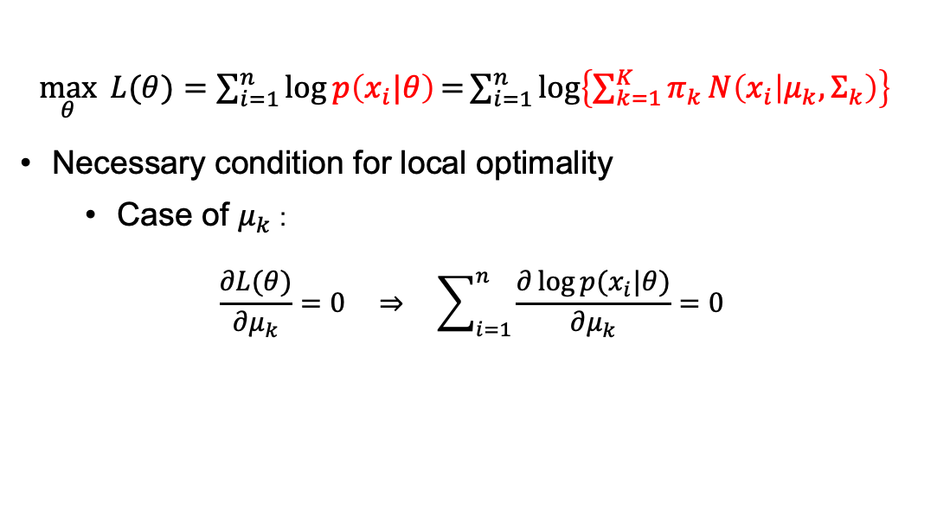
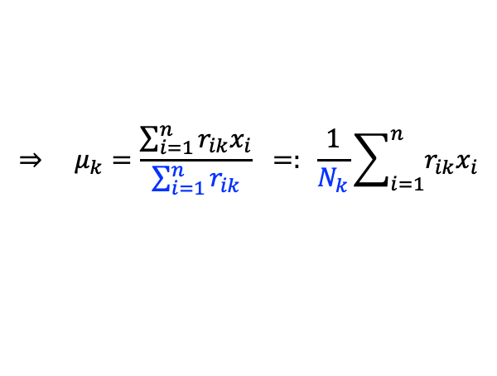
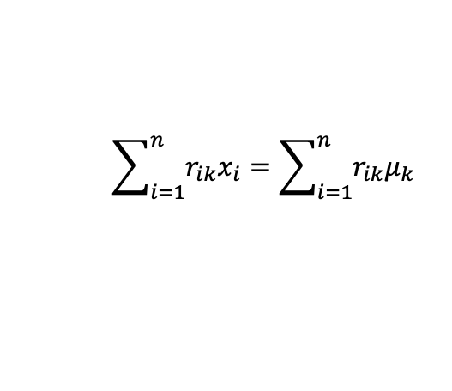
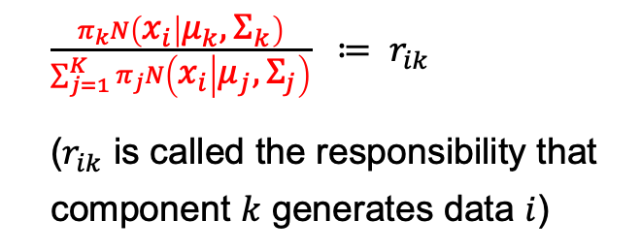
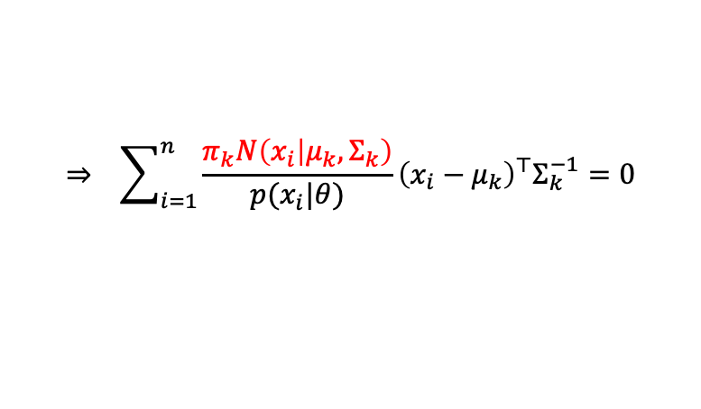
GMM – Parameter Estimation (Learning)
$\max_{θ}{ L(θ)=\sum_{i=1}^{n}{\log{p\left(x_{i}|θ\right)}\text{=}\sum_{i=1}^{n}{\log\left\{\sum_{k=1}^{K}{π_{k}}N\left(x_{i} | μ_{k},Σ_{k}\right)\right\}}}}$
Necessary condition for local optimality
Case of $μ_{k}$ :
$$\frac{∂L(θ)}{∂μ_{k}}=0 ⇒ \sum_{i=1}^{n}{\frac{∂\log{p(x_{i}|θ)}}{∂μ_{k}}}=0$$
$$⇒ \sum_{i=1}^{n}{\frac{π_{k}N\left(x_{i} | μ_{k},Σ_{k}\right)}{p(x_{i}|θ)}}{\left(x_{i}−μ_{k}\right)}^{⊤}Σ_{k}^{−1}=0$$
$$\sum_{i=1}^{n}{r_{ik}x_{i}}=\sum_{i=1}^{n}{r_{ik}μ_{k}}$$
$\frac{π_{k}N\left(x_{i} | μ_{k},Σ_{k}\right)}{\sum_{j=1}^{K}{π_{j}}N\left(x_{i} | μ_{j},Σ_{j}\right)} ≔ r_{ik}$
($r_{ik}$ is called the responsibility that component $k$ generates data $i$)
$$⇒ μ_{k}=\frac{\sum_{i=1}^{n}{r_{ik}x_{i}}}{\sum_{i=1}^{n}{r_{ik}}} =: \frac{1}{N_{k}}\sum_{i=1}^{n}{r_{ik}x_{i}}$$

Slide 16
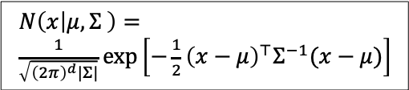
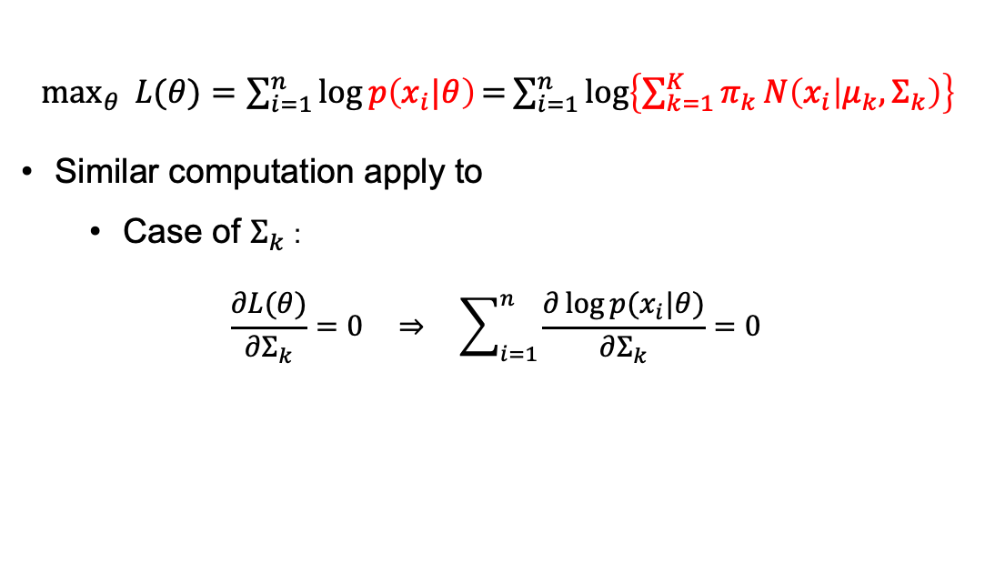
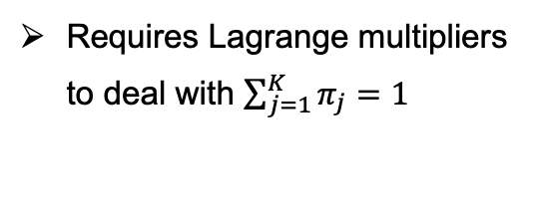
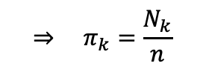
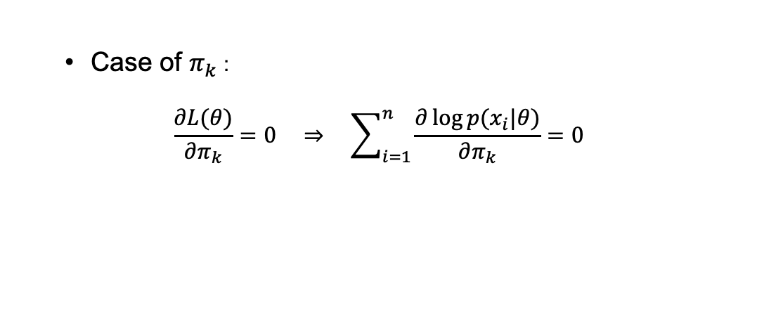


GMM – Parameter Estimation (Learning)
$\max_{θ}{ L(θ)=\sum_{i=1}^{n}{\log{p\left(x_{i}|θ\right)}\text{=}\sum_{i=1}^{n}{\log\left\{\sum_{k=1}^{K}{π_{k}}N\left(x_{i} | μ_{k},Σ_{k}\right)\right\}}}}$
Similar computation apply to
Case of $Σ_{k}$ :
$$\frac{∂L(θ)}{∂Σ_{k}}=0 ⇒ \sum_{i=1}^{n}{\frac{∂\log{p(x_{i}|θ)}}{∂Σ_{k}}}=0$$
$N\left(x | μ,Σ \right)=$
$\frac{1}{\sqrt{{\left(2π\right)}^{d}|Σ|}}\exp\left[−\frac{1}{2}{\left(x−μ\right)}^{⊤}Σ^{−1}(x−μ)\right]$
Matrix derivatives:
$\frac{dA^{−1}\left(x\right)}{dx}=−A^{−1}\frac{dA}{dx}A^{−1}$
$\frac{d|A\left(x\right)|}{dx}=\left|A\right| Tr\left(A^{−1}\frac{dA}{dx}\right)$
$$⇒ Σ_{k}= \frac{1}{N_{k}}\sum_{i=1}^{n}{r_{ik}}\left(x_{i}−μ_{k}\right){\left(x_{i}−μ_{k}\right)}^{⊤}$$
Case of $π_{k}$ :
$$\frac{∂L(θ)}{∂π_{k}}=0 ⇒ \sum_{i=1}^{n}{\frac{∂\log{p(x_{i}|θ)}}{∂π_{k}}}=0$$
$$⇒ π_{k}=\frac{N_{k}}{n}$$
Requires Lagrange multipliers to deal with $\sum_{j=1}^{K}{π_{j}=1}$
These results do not admit a closed-form solution.
Instead, they suggest a simple iterative algorithm rather than direct gradient ascent.

Slide 17

EM Algorithm for GMM
Expectation-maximization (EM) algorithm for Gaussian mixture
Initialize parameters: $θ=\{π_{k},μ_{k},Σ_{k}\}$
E-step: Evaluate responsibilities $r_{ik}$ for every data point $x_{i}$ using current parameters $π_{k},μ_{k},Σ_{k}$:
$r_{ik}=\frac{π_{k}N\left(x_{i} | μ_{k},Σ_{k}\right)}{\sum_{j=1}^{K}{π_{j}}N\left(x_{i} | μ_{j},Σ_{j}\right)}$
M-step: Re-estimate parameters $π_{k},μ_{k},Σ_{k}$ using current responsibilities $r_{ik}$:
$π_{k}=\frac{N_{k}}{n}$ ($N_{k}=\sum_{i=1}^{n}{r_{ik}}$)
$μ_{k}=\frac{1}{N_{k}}\sum_{i=1}^{n}{r_{ik}x_{i}}$
$Σ_{k}= \frac{1}{N_{k}}\sum_{i=1}^{n}{r_{ik}}\left(x_{i}−μ_{k}\right){\left(x_{i}−μ_{k}\right)}^{⊤}$
Evaluate the log likelihood: $L(θ)=\sum_{i=1}^{n}{\log{p\left(x_{i}|θ\right)}\text{=}\sum_{i=1}^{n}{\log\left\{\sum_{k=1}^{K}{π_{k}}N\left(x_{i} | μ_{k},Σ_{k}\right)\right\}}}$
Iterate between E-step and M-step until convergence.

Slide 18


EM Algorithm for GMM – Example
E-step: Evaluate responsibilities $r_{ik}$:
$r_{ik}=\frac{π_{k}N\left(x_{i} | μ_{k},Σ_{k}\right)}{\sum_{j=1}^{K}{π_{j}}N\left(x_{i} | μ_{j},Σ_{j}\right)}$
M-step: Re-estimate parameters:
$π_{k}=\frac{N_{k}}{n}$ ($N_{k}=\sum_{i=1}^{n}{r_{ik}}$)
$μ_{k}=\frac{1}{N_{k}}\sum_{i=1}^{n}{r_{ik}x_{i}}$
$Σ_{k}= \frac{1}{N_{k}}\sum_{i=1}^{n}{r_{ik}}\left(x_{i}−μ_{k}\right){\left(x_{i}−μ_{k}\right)}^{⊤}$
Déjà vu?
GMM is a soft (probabilistic) version of the classic k-means clustering.
Notes:
(a): init. (b): E-step (update hidden state). (c): M-step (update model)
(d): E-step. (e): M-step. …

Slide 19


GMM – The Latent-Variable Perspective
$z=(z_{1},…,z_{K})$ is a a discrete latent variable. Exactly one entry of $z$ is 1, all others are 0 (one-hot coding).
For every observed data point $x_{i}$ there is a corresponding latent variable $z_{i}$, which indicates which mixture component generated $x_{i}$.
Posterior $p\left(z_{k}=1 | x_{i}\right)=\frac{p\left(z_{k}=1\right)p\left(x_{i}\right|z_{k}=1) }{p\left(x_{i}\right)}=\frac{π_{k}N\left(x_{i} | μ_{k},Σ_{k}\right)}{\sum_{j=1}^{K}{π_{j}}N\left(x_{i} | μ_{j},Σ_{j}\right)}$, which corresponds to the responsibility $r_{ik}$ before.
Latent-variable perspective gives rise to a general EM algorithm for MLE.
EM algorithm iteratively maximizes a lower bound on the log likelihood $L\left(θ\right)=\log{p(D|θ)}$, thus ensuring convergence to a local maxima.

Slide 20





EM for GMM by mclust (R Package)
How to determine the number of components?
In higher dimensions, one may also need to decide the “shape” of each Gaussian.
Problem of model selection

Slide 21

Different Gaussian Models
"E": equal variance (univariate)
"V": variable variance (univariate)
"EII": spherical, equal volume
"VII": spherical, unequal volume
"EEI": diagonal, equal volume and shape
"VEI": diagonal, varying volume, equal shape
…
"VVV": ellipsoidal, varying volume, shape, and orientation.
For more details, refer to mclust::mclustModelNames

Slide 22









Model Selection
Shall we simply pick the model with the largest (log) likelihood?
A sensible choice in many cases, when we are primarily interested in fitting the data.
Caution is needed when dealing with flexible models, like GMM.
$K=2$, $L\left(θ\right)=−513$
$K=4$, $L\left(θ\right)=−504$
One can improve the fitting of GMM by increasing model complexity.
2D toy data
$K=8$, $L\left(θ\right)=−490$
$K=8$, $L\left(θ\right)=−480$

Slide 23

Model Selection
Model selection is a central problem in statistical learning, which is also a recurrent theme in this course.
Essentially we want to fit, but not overfit the existing data, as we are typically more interested in generalizing the model to unseen data.
One basic principle to help to achieve this
Choose the simplest model that explains the data reasonably well (Occam’s Razor)
More convenient to exploit this principle in the view of Bayesian (e.g., place heavier prior on simpler models)

Slide 24

Model Selection – Information Criteria
Correct for the bias of MLE by addition of a penalty term to compensate for the overfitting of more complex models (with lots of parameters)
Akaike Information Criterion, AIC (Akaike 1974):
$AIC=\log{p\left(D | θ^{MLE}\right)}−M$
where $M$ is the number of model parameters.
Bayesian Information Criterion, BIC (Schwarz 1978) (for exponential family distributions):
$BIC=\log{p(D)}=\log{∫p\left(D | θ\right)p\left(θ\right)dθ}≈\log{p\left(D | θ^{MLE}\right)}−\frac{1}{2}M\log{n}$
where $n$ is the number of data points.
BIC penalizes model complexity more heavily than AIC
Remark: the AIC and BIC defined in some literature may differ from here with a multiplicative constant and a minus sign.
Notes:
nu: no. of parameters
n: sample size

Slide 25







Model Selection – Information Criteria
$K=2$
$L\left(θ\right)=−513$
$BIC=−1073$
$K=4$
$L\left(θ\right)=−504$
$BIC=−1099$
$K=8$
$L\left(θ\right)=−490$
$BIC=−1155$
$K=8$
$L\left(θ\right)=−480$
$BIC=−1215$
$BIC v.s. K$
Here, the larger BIC the better.
Some people define BIC s.t. it is the smaller the better.

Slide 26










Classification and Prediction – Using mclust
$$r_{ik}=p\left(z_{k}=1 | x_{i}\right)=\frac{π_{k}N\left(x_{i} | μ_{k},Σ_{k}\right)}{\sum_{j=1}^{K}{π_{j}}N\left(x_{i} | μ_{j},Σ_{j}\right)}$$
$$⇒ p\left(z_{k}=1 | x\right)$$
BIC selects a 2-component model (see summary(mytest))
Notes:
A natural classification rule:
Classification boundary lies at around x = 5.4.

Slide 27

Case Study – Diabetes (糖尿病)
Diabetes has become a severe public health problem.
Quote from a recent study [BMJ 2020; 369]:
“The weighted prevalence of total diabetes (n=9772), self-reported diabetes (n=4464), newly diagnosed diabetes (n=5308), and prediabetes (n=27 230) diagnosed by the ADA criteria were 12.8% (95% confidence interval 12.0% to 13.6%), 6.0% (5.4% to 6.7%), 6.8% (6.1% to 7.4%), and 35.2% (33.5% to 37.0%), respectively, among adults living in China.”
Prevalence of diabetes recorded in mainland China using 2018 diagnostic criteria from the American Diabetes Association: national cross sectional study
BMJ 2020; 369 (https://www.bmj.com/content/369/bmj.m997)
Notes:
“High blood sugar is damaging to the body and can cause other serious health problems.”

Slide 28


Case Study – Diabetes (糖尿病)
Type 1 Diabetes: pancreas doesn’t make insulin (胰岛素) or makes very little insulin
Type 2 Diabetes: cells don’t respond normally to insulin (insulin resistance); insufficient production of insulin

Slide 29



diabetes data in mclust
Notes:
餐后血糖、胰岛素、稳态血糖(空腹血糖)

Slide 30




diabetes data in mclust
Marginal distribution of three important features
Multimodal structure of the kernel density plot

Slide 31

diabetes data in mclust
Scatter plots between two variables
Multiclass structure

Slide 32



diabetes data – Investigating glucose and insulin
(VEV, 2) gives the largest BIC.
Notes:
Common sense:
Normal people has low both glucose and insulin.
Type 2: high glucose -> need high insulin (due to Insulin resistance)

Slide 33


diabetes data – Investigating glucose and insulin
Optimal GMM is a 2-component model.
Identifiability issue:
Though GMM gives two clusters, but one cannot decide purely from GMM that which class a cluster belong too.

Slide 34

diabetes data – Using all 3 features
Using all the 3 features yields an optimal GMM with 3 components.
Note that the original data happens to have 3 types of people.

Slide 35


diabetes data – Using all 3 features
Workaround to identify the class label for a cluster
Only for the purpose to evaluate our GMM model; this may not be doable in practice.
The data speaks for itself !!
But is it accurate enough ?

Slide 36

diabetes data – 1 Layer Neural Net
The accuracy is better than GMM, But the information of labels has been used here (supervised).
The unsupervised GMM is actually not bad, when the data has a clustered structure.

Slide 37





diabetes data – some statistical inference by MclustBootstrap
…
Remind the fitted parameters:

Slide 38
Some diabetes data to play with
In Azure Open Datasets
https://docs.microsoft.com/en-us/azure/open-datasets/dataset-diabetes?tabs=azureml-opendatasets
442 samples with 10 features
In UCI
https://archive.ics.uci.edu/ml/datasets/diabetes
Diabetes patient records obtained from two sources: an automatic electronic recording device and paper records

Slide 39


GMM – Some Limitations
2D artificial data
Fitted to a GMM with 20 components
GMM can fit (to some degree), but probably it is not ideal…

Slide 40
Generative Models *
* This is a big and rapidly evolving topic.
Only some selected ideas will be presented, at the introductory level.

Slide 41






From Density Estimation to Generative Models
In above examples, we aim to fit some data to a density $P(X)$, without using supervised labels.
Assumption: there is a true underlying distribution $P(X)$ governing the generation of data
Target: learn this true distribution $P(X)$
In many cases, the targeted distribution are very complex
Difficult to accommodate them explicitly in a parametric model
By learning, sometimes it is already very useful if we can sample from the targeted distribution.
Generative models
Method: minimize some “distance” measure between the model and the empirical distribution (a.k.a. the data).
$$\sim P(X)$$
$$\min_{θ}{"Distance"}\left(P\left(X\right)||P_{θ}(X)\right)$$
$P\left(X\right)$ is unknown, so replace it by the empirical distribution.
KL divergence is one choice of “distance” for this purpose.
$$P_{\hat{θ}}\left(X\right) →$$
A general pipeline for learning a generative model.

Slide 42




Popular (Deep) Generative Models
Energy-based models
$P_{θ}\left(X\right)=\frac{1}{Z}e^{−E_{θ}(X)}$, e.g., Restricted Boltzmann Machine (RBM)
Generative adversarial networks (GAN)
Real sample: $X\sim P^{r}(X)$; fake sample: $X=G_{θ}\left(Z\right), Z\sim P^{simple}(Z)$
Training requires discriminating the real and the fake
Variational auto-encoders (VAE)
Decoder: $X=P_{θ}\left(X|Z\right), Z\sim P^{simple}\left(Z\right), (\dim{Z}≪\dim{X})$
Encoder: $q_{φ}(Z|X)$
Normalizing flow
Change of variable $→$ change of density
$X=T_{θ}\left(U\right), U\sim P^{simple}\left(U\right), (\dim{U}=\dim{X})$
Score-based models / Diffusion models (current SOTA)
Reversing a physical diffusion process
$$\sim P(X)$$
$$\min_{θ}{"Distance"}\left(P\left(X\right)||P_{θ}(X)\right)$$
$$P_{\hat{θ}}\left(X\right) →$$
A general pipeline for learning a generative model.
Notes:
Note: Generator in GAN is like a decoder.

Slide 43



Example – Generative Adversarial Networks (GAN)
$$\min_{θ}{"Distance"}\left(P\left(X\right)||P_{θ}(X)\right)$$
We have been using KL divergence as the “distance” measure for learning a distribution, leading to MLE.
Many other information divergence measures were also used in the literature, e.g., in training GAN.
But they have some intrinsic limitations.

Slide 44








Limitations of KL and Related Divergence
Consider three distributions $P_{0},P_{1},P_{2}$; assume that they have the same shape but no overlap.
Which distributions are closest?
KL divergence: $D_{KL}(P || Q)$ =$∫P(x)\log{\frac{P(x)}{Q(x)}} dx$
$D_{KL}(P_{0} || P_{1})=D_{KL}(P_{1} || P_{2})=D_{KL}(P_{0} || P_{2})=∞$
No overlap between the supports of distributions
Jensen-Shannon divergence: let $M=\frac{P+Q}{2}$, then
$D_{JS}(P || Q)=\frac{1}{2}D_{KL}(P || M)\text{+}\frac{1}{2}D_{KL}(Q || M)$
$D_{JS}(P_{0} || P_{1})=D_{JS}(P_{1} || P_{2})=D_{JS}(P_{0} || P_{2})=const$
No effective gradient information
No effective learning
$$P_{0}(x)$$
$$P_{1}(x)$$
$$P_{2}(x)$$
$$D_{JS}(P_{0} || P_{1})$$
$$x_{1}−x_{0}$$
Notes:
Some workaround: add noises to enforce overlap, but it is not a principled treatment.

Slide 45






Limitations of KL and Related Divergence
The no-overlapping issue is not rare in statistical learning
Many high-dimensional data live in some low-dimensional manifold
Different clusters of data may not overlap
The so-called Wasserstein distance provides a resolution to this challenge
Based on optimal transport theory
$$P_{0}(x)$$
$$P_{1}(x)$$
$$P_{2}(x)$$
Intuitively,
$“D”(P_{0} || P_{1})<“D”(P_{0} || P_{2})$

Slide 46



Optimal Transport Problem
Very rich mathematical structure
Probability theory, Riemannian geometry, …
Applications in many fields
Operation research, image analysis, statistical physics, machine learning, …
Monge’s problem of optimal transport
Want to transport “resources” (probability mass here) from the source distribution $μ$ to target distribution $ν$, under the minimal cost
Cost $c(x,y)$ is related to distance from $x$ to $y$
Respect the metric on $Ω$
Difficulty
Existence of solution $T(⋅)$
The optimization is not easy

Slide 47






Kantorovich’s Relaxation
$$γ\left(x,y\right)$$
Instead of maps $T:Ω→Ω$, Kantorovich consider probabilistic maps, i.e. couplings $γ(x,y)∈𝒫(Ω×Ω)$, satisfying $∫γ\left(x,y\right)dy=μ(x)$, $∫γ\left(x,y\right)dx=ν(x)$
Consider Euclidean space $Ω=ℝ^{d}$, and transport cost: $c\left(x,y\right)={\left\|x−y\right\|}^{p}$
Optimal transport problem (Kantorovich’s version)
$$W_{p}\left(μ,ν\right)=\min_{γ∈𝒫}{\int{{\left\|x−y\right\|}^{p}γ\left(x,y\right)dxdy}}=𝔼_{\left(x,y\right)\sim γ}\left({\left\|x−y\right\|}^{p}\right)$$
$W_{p}{\left(μ,ν\right)}^{1/p}$ : p-Wasserstein distance, earth mover’s distance (推土机距离)
Do no need the distributions to have overlapping support.
Works for continuous and discrete distributions (histogram, empirical).
The optimization is more tractable.
Effective gradient information is available, even when $μ$ and $ν$ have no overlapping support.
Notes:
Further reduction of computational complexity by entropy regularization -> Sinkhorn algorithm (M. Cuturi).

Slide 48











Solving Optimal Transport – The Discrete Case
Discrete measure:
$α=\sum_{i=1}^{n}{a_{i}δ_{x_{i}}}$ $(a_{i}≥0, \sum_{i}{a_{i}}=1)$
Example: the empirical measure of data $\{x_{i}\}$:
$α=\frac{1}{n}\sum_{i=1}^{n}{δ_{x_{i}}}$
Consider
source distribution: $α=\sum_{i=1}^{n}{a_{i}δ_{x_{i}}}$
Target distribution: $β=\sum_{i=1}^{m}{b_{i}δ_{y_{i}}}$
Optimal transport from $α$ to $β$ becomes a linear programing problem
$\min_{γ∈𝒫}{\sum_{ij}{γ_{ij}}c(x_{i},y_{j})}$
s.t. $\sum_{j}{γ_{ij}}=a_{i}$, $\sum_{i}{γ_{ij}}=b_{j}$
$$\frac{1}{ε}$$
$δ_{x_{i}}$is a Dirac delta function:
$$δ_{x_{i}}\left(x\right)=δ\left(x−x_{i}\right)=\left\{\begin{aligned}∞, x=x_{i} \\ 0, x≠x_{i}\end{aligned}\right.$$
with $∫δ_{x_{i}}\left(x\right)dx=1$
$$x$$
$$x_{i}−\frac{ε}{2}$$
$$x_{i}+\frac{ε}{2}$$
where $ε→0$

Slide 49


Solving Optimal Transport – The Discrete Case
Linear programing for optimal transport:
$\min_{γ∈𝒫}{\sum_{ij}{γ_{ij}}c(x_{i},y_{j})}$ s.t. $\sum_{j}{γ_{ij}}=a_{i}$, $\sum_{i}{γ_{ij}}=b_{j}$
Generic exact solver has a time complexity $O(n^{3}\log{(n)})$
Breakthrough of computation in 2013, when M. Cuturi introduced the entropic regularized optimal transport:
$\min_{γ∈𝒫}{\sum_{ij}{γ_{ij}}c(x_{i},y_{j})} ⇒ \min_{γ∈𝒫}{\sum_{ij}{γ_{ij}}c(x_{i},y_{j})}+ε\sum_{ij}{γ_{ij}}\log{(γ_{ij})}$
A strongly convex problem
Leads to the Sinkhorn algorithm, with complexity $O(n^{2})$
Fast implementation in parallel, GPU friendly
Many recent developments for the semi-discrete case and continuous case as well.
Python package:
POT ## (Python Optimal Transport)
Many algorithms and example applications
https://pythonot.github.io/
Notes:
Sinkhorn: iteratively update the dual variables.
The continuous case: solve the Monge-Ampere’s equation for the transport map.
The semi-discrete case: optimal transport map can be determined by the weights of a power diagram.

Slide 50

Applications in Statistics and Machine Learning
Many classical problems in traditional statistics and modern machine learning can be “Wassersteinized”.
Replace the KL divergence in MLE by the Wasserstein distance
Minimum Kantorovich Estimator (MKE)
Wasserstein RBM
Wasserstein GAN
Wasserstein VAE
…

Slide 51


Wasserstein GAN
Wasserstein GAN – [M. Arjovsky, et al., ICML 2017]
Easy to implement by small modifications to the regular GAN
More effective training in comparison to the regular GAN based information divergences
Alleviate the mode collapse issue (see next page)
Notes:
让 optimal transport 火出圈的工作

Slide 52

Wasserstein GAN
Wasserstein GAN alleviates the mode collapse problem.
Mode collapse problem:
The generator collapses into a single mode, or a single type of output
Lack of diversity
Figure: Different methods learning a mixture of 8 gaussians spread in a circle.
This issue is further investigated theoretically by analyzing singularities of the transport map.
- [Z. Luo, et al., The Singularity Set of Optimal Transportation Maps, 2022]

Slide 53





Geodesic (测地) structure of probabilities
Unlike the KL divergence, Wasserstein distance is a genuine distance measure
Symmetric and satisfies the triangle inequality
Defines a metric space (with a geodesic structure) for probability measures
Morphing by optimal transport
- Refs:
S. Kolouri, et al., Optimal Mass Transport, Signal processing and machine- learning applications, 2017
B. Lévy and E. Schwindt, Notions of optimal transport theory and how to implement them on a computer, 2017
Shape interpolation by optimal transport

Slide 54








Geodesic structure of probabilities
Consider the Kantorovich problem, transporting $α_{0}$ to $α_{1}$ with optimal coupling $γ(x,y)$
Define $P_{t}\left(x,y\right)=\left(1−t\right)x+ty$, $0≤t≤1$
Geodesic: $α_{t}=P_{t\#}γ$
In discrete case:
$α_{t}=\sum_{ij}{γ_{ij}}δ_{\left(1−t\right)x_{i}+ty_{j}}$
R package:
transport, WSGeometry
source
target

Slide 55





Wasserstein Barycenters (质心)
Wasserstein Barycenters:
$\min_{μ}{\sum_{i=1}^{n}{W_{p}(μ,ν_{i})}}$
In POT (Python):
ot.barycenter(), ...
Q: how to summarize the common features of these images (viewed as empirical probabilities $\{ν_{i}\}$)?
Some naïve averages
Further reading on optimal transport:
G. Peyré and M. Cuturi, Computational Optimal Transport, 2018
https://optimaltransport.github.io
[Ref: M. Cuturi, Fast Computation of Wasserstein Barycenters, 2014]

Slide 56








Generative Model for Sampling
For successfully trained GAN, it is relatively easy to generate samples:
Sample the latent code: $Z\sim P(Z)$
Transform variable: $X=G_{θ}(Z)$
Usually $\dim{Z≪\dim{X}}$
$Z$ is considered a reduced representation of $X$.
$G_{θ}(⋅)$: typically a neural network
This process implicitly defines a distribution for $P_{θ}(X)$
May not be desirable enough, e.g., for likelihood evaluation and performing statistical inference…
Resort to normalizing flow
Generator of GAN:
$$Z\sim P^{simple}(Z)$$
$X=G_{θ}\left(Z\right)$
Decoder of VAE:
$$Z\sim P^{simple}(Z)$$
$X\sim P_{θ}\left(X|Z\right)$
Notes:
Being able to evaluate likelihood can help us to do other tasks, e.g., anomaly detection.
There is an explicit density $P_{θ}\left(X\right)$ in VAE, but it is very difficult to compute;
in its training, one usually works on the lower bound of log likelihood, etc (variational Bayes).

Slide 57








Normalizing Flow
Sample generation in normalizing flow
$u∼p_{u}(u)$
$x=T(u)$
Here, $\dim{u}=dim{x}$, and require $T(⋅)$ to have an inverse: $T^{−1}(⋅)$ (bijective)
Density of $x$ is available:
$p_{x}\left(x\right)=p_{u}\left(u\right){\left|\det{J_{T}\left(u\right)}\right|}^{−1}$
with Jacobian
Complex $T\left(⋅\right) ⇒$ Complex $P_{x}(x)$

Slide 58



Normalizing Flow
$u∼p_{u}(u)$
$x=T(u)$
$p_{x}\left(x\right)=p_{u}\left(u\right){\left|\det{J_{T}\left(u\right)}\right|}^{−1}$
Want:
Expressive and invertible $T(⋅)$
Tractability of $\det{J_{T}(u)}$
Usually implemented by some special neural networks
Further reading:
G. Papamakarios, et al., Normalizing Flows for Probabilistic Modeling and Inference, JMLR 2021

Slide 59




Normalizing Flow – Application in Particle Physics
Too many BSM theories to look at one by one.
Normalizing flow offers a model-agnostic method for estimating the likelihood ratio
$E=mc^{2}$
Higher energy $⇒$ more diverse and heavier particles can be produced.
Dictated by the law of quantum theory, therefore probabilistic.
This is useful for anomaly discovery.
Background: standard model (of particle physics)
Signal (anomaly): beyond standard model (BSM)
- Ref:
B. Nachman and D. Shih, Anomaly detection with density estimation, PRD 101, 075042 (2020)
Notes:
Background of SM: usually also a complex distribution, but can be sampled from MCMC.
Therefore there is also a need to estimate the density of the background.

